Slide 1

TELEPASS data analyst presentation
TEST SOLUTIONS REPORT

Slide 2
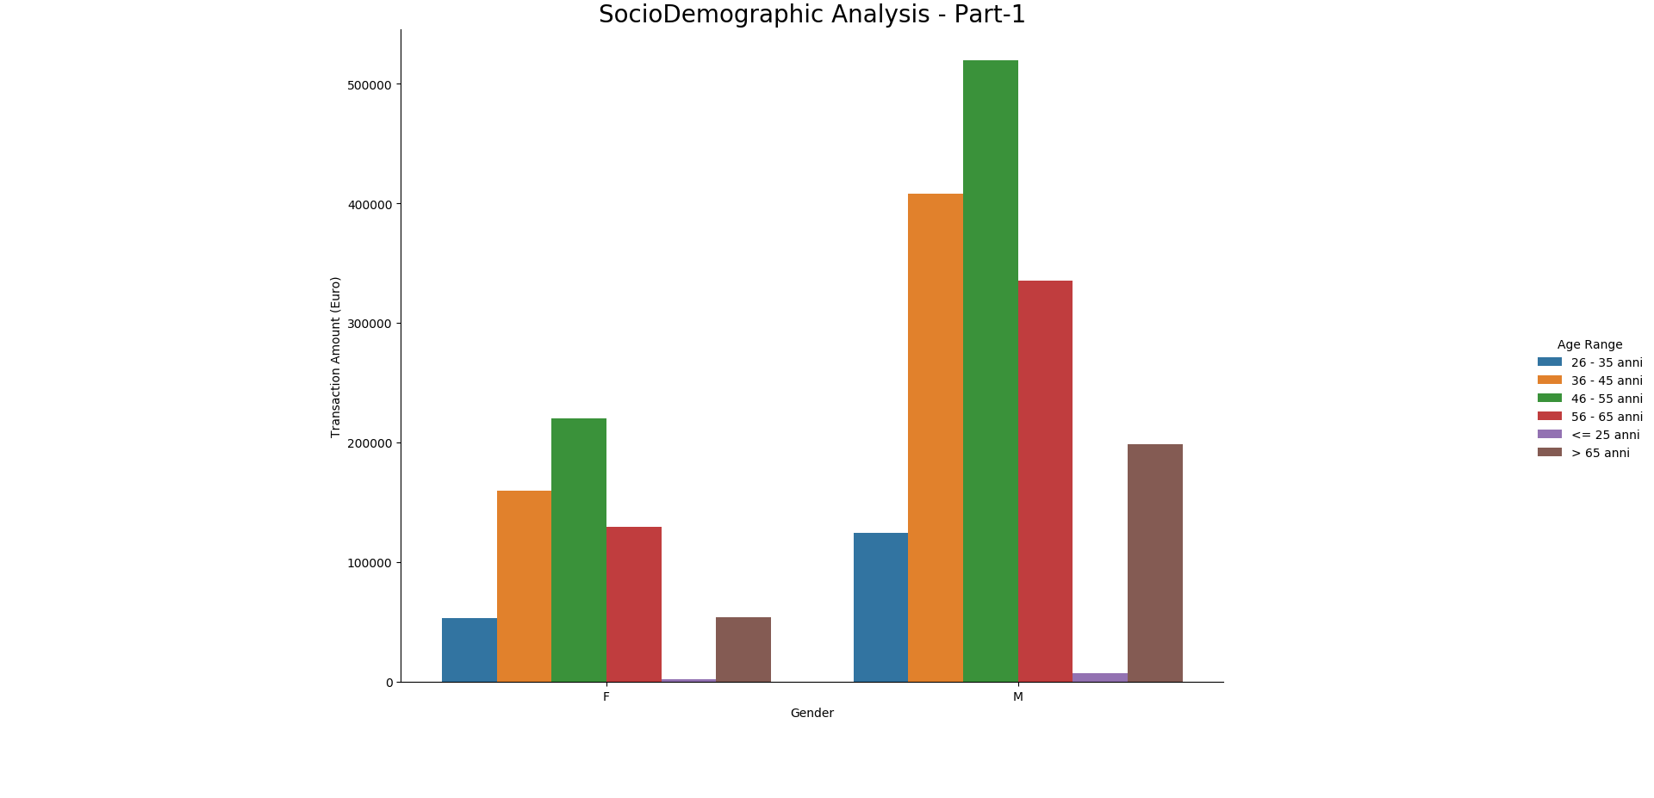
Socio-demographic analysis

Slide 3
Insights on the SOCIO-DEMOGRAPHIC analysis - 1
the HIGHEST PAYING customers are male WITH THE AGE GROUP RANGE 46-55, Followed by MALES with the age group 36-45, and then comes the males with the age group 56-65.
Though there are less female customers, THE SIMILAR AGE GROUP PAYING PATTERN IN MALE GROUP IS OBSERVED IN FEMALE GROUP.
BY THIS IT’S CLEAR ON GENEDER WISE IT’S MALE WHO ARE MAJORITY OF THE CUSTOMERS FOR TELEPASS PAY APPLICATION AND WITH THE AGE GROUP 46-55 CONTRIBUTING HIGHEST TO THE TRANSACTION AMOUNT.

Slide 4
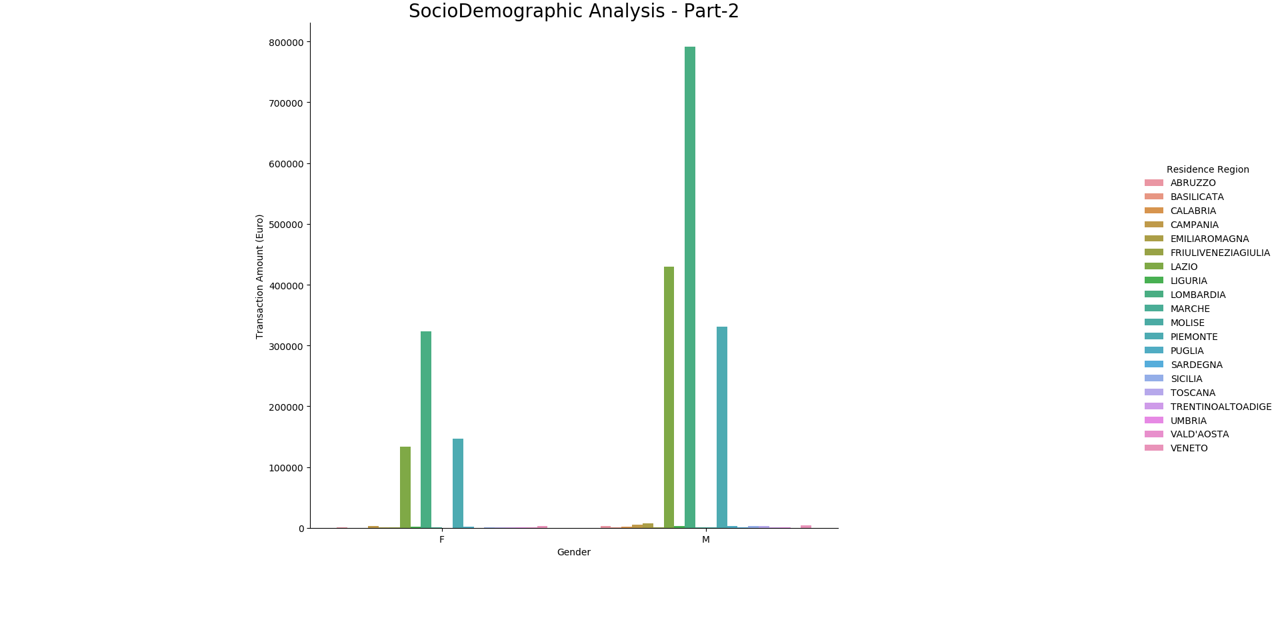
Socio-demographic analysis

Slide 5
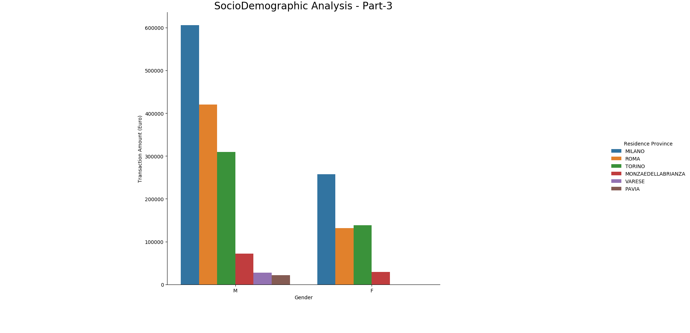
Socio-demographic analysis

Slide 6
Insights on the SOCIO-DEMOGRAPHIC analysis - 2
ON residence region and province wise, THE HIGHEST CONTRIBUTING GROUP IS MALE FROM LOMBARDIA REGION AND MILANO PROVINCE, FOLLOWED BY MALE FROM LAZIO REGION AND ROMA PROVINCE AND THEN COMES THE MALE FROM PIEDMONTE REGION AND TORINO PROVINCE.
THOUGH THIS DOESN’T SAY A LOT ABOUT THE INDIVIDUAL CUSTOMERS, THESE ANALYSIS WILL BE HELPFUL IN FINDING THE TARGET GROUPS:

Slide 7
TARGET GROUPS BASED ON SOCIO-DEMOGRAPHIC ANALYSIS
TARGET GROUP 1 – MALES WITH THE AGE GROUP 46-55 FROM THE LOMBARDIA REGION AND MILANO PROVINCE
TARGET GROUP 2 – MALES WITH THE AGE GROUP 36-45 FROM THE LAZIO REGION AND ROMA PROVINCE
TARGET GROUP 3 - MALES WITH THE AGE GROUP 56-65 FROM THE PIEDMONTE REGION AND TORINO PROVINCE

Slide 8
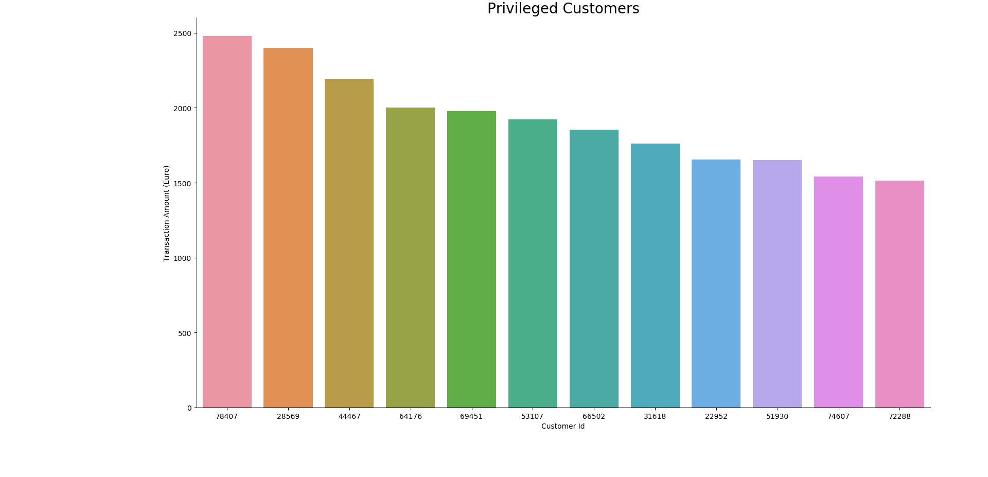
Privileged customers

Slide 9
TARGET CUSTOMERS BASED ON HIGHEST TRANSACTION AMOUNT
PRIVILIGED CUSTOMERS ARE CALCULATED BY FILTERING THE CUSTOMERS WHO SPENT HIGHER THAN 1500 EURO’S OVERALL IN THE YEAR 2019 FROM THE TARGET GROUPS.
THEARE ARE 12 CUSTOMERS WHO SPENT MORE THAN 1500 EURO’S IN THE YEAR 2019, THEIR SOCIO-DEMOGRAPHIC INFORMATION IS AVAILABLE FOR YOUR REFERENCE IN THE BELOW ATTACHED SHEET.

Slide 10
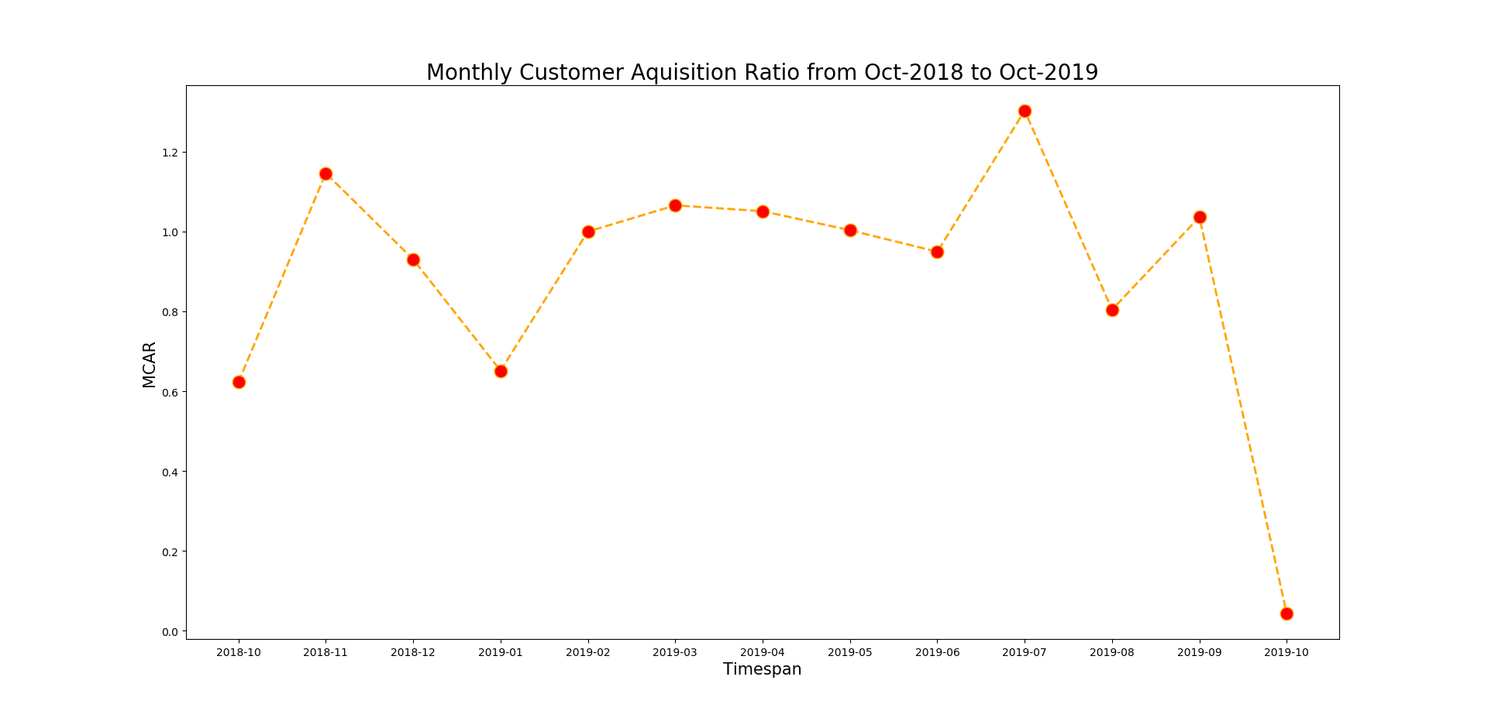
MCAR

Slide 11
Insights on MCAR FROM OCT/2018 TO OCT/2019
THE MONTHLY CUSTOMER ACQUISITION RATIO STARTS AT 0.62 ON OCT/2018 AND GOES HIGH TO 1.3 ON JUL/2019 AND GETS THE LOWEST TO 0.042 ON OCT/2019.
Through out the year it fluctuates between 0.62 and 1.3 except on oct/2019 it drastically dropped to 0.042.
A root cause analysis need to be performed to find out the reason for the drastic drop in mcar on oct/2019

Slide 12
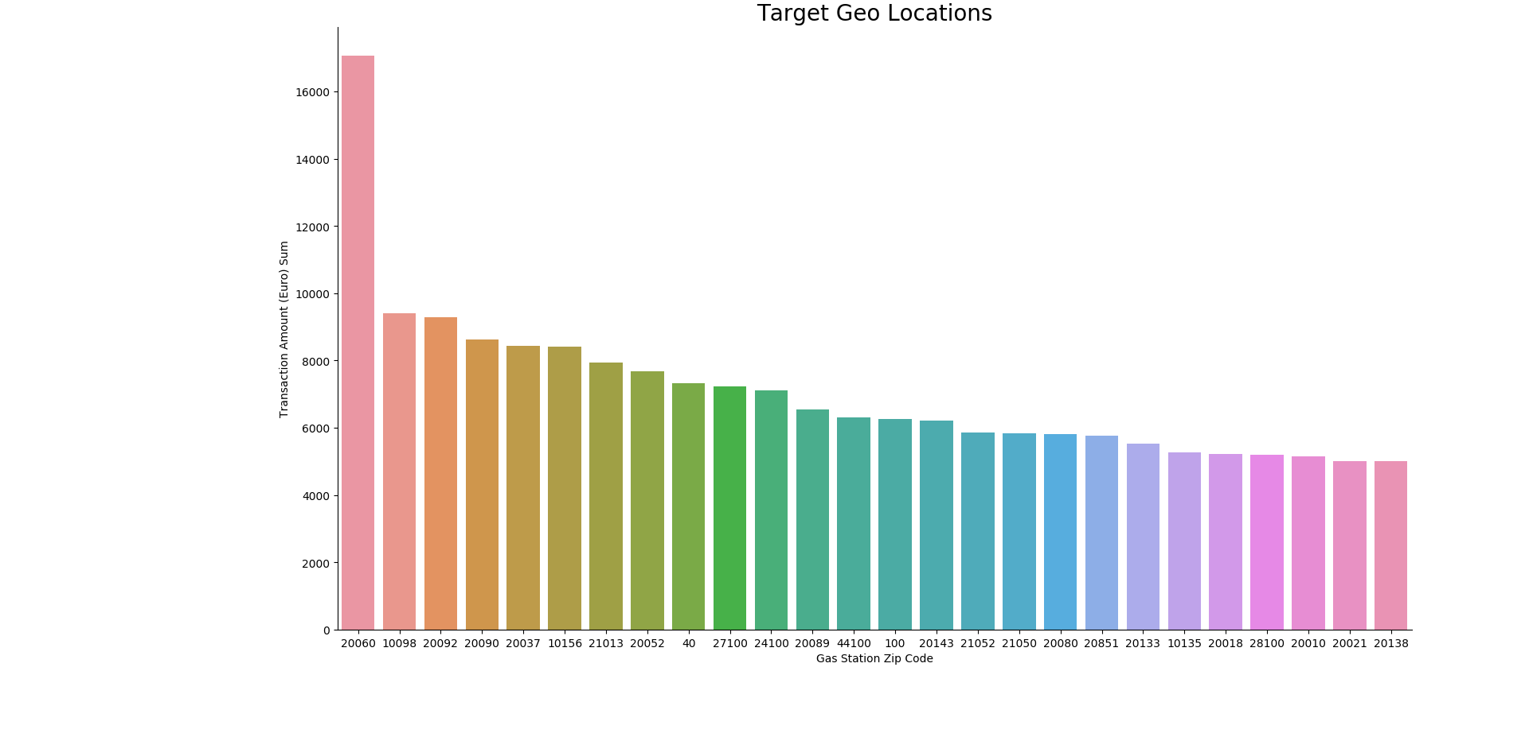
TARGET GEO LOCATIONS BASED ON TRANSACTION AMOUNT

Slide 13
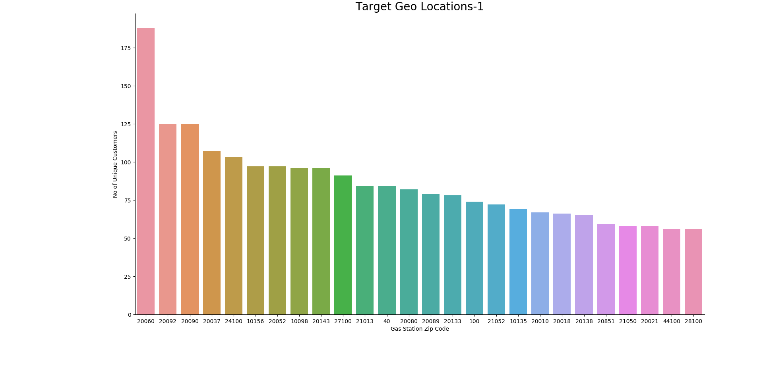
TARGET GEO LOCATIONS BASED ON NO. OF UNIQUE CUSTOMERS

Slide 14
INSIGHTS ON TARGET GEO LOCATIONS
FOR THE TARGET GEO LOCATIONS ANALYSIS, I have taken the November month as it has highest number of transactions in the year 2019.
I BELIEVE METRICS LIKE TRANSACTION AMOUNT, NO.OF.TRANSACTIONS, DISPENSED LITRES, UNIQUE CUSTOMERS AND RATIO OF (TRANSACTION AMOUT/DISPENSED LITRES) WILL PLAY A MAJOR ROLE IN DECIDING THE TARGET GEO LOCATIONS
THE ABOVE TWO SLIDES SHOWS THE TARGET GEO LOCATIONS BASED ON TRANSACTION AMOUNT AND UNIQUE CUSTOMERS FOR THE TRANSACTION AMOUNT > 5000 IN THE NOVEMBER MONTH.

Slide 15


